Slide 1
Clause Learning and Dependency-directed backtracking
Slides by Lintao Zhang from Microsoft Research
Narrated by Frank van Harmelen
Lintao Zhang

Slide 2
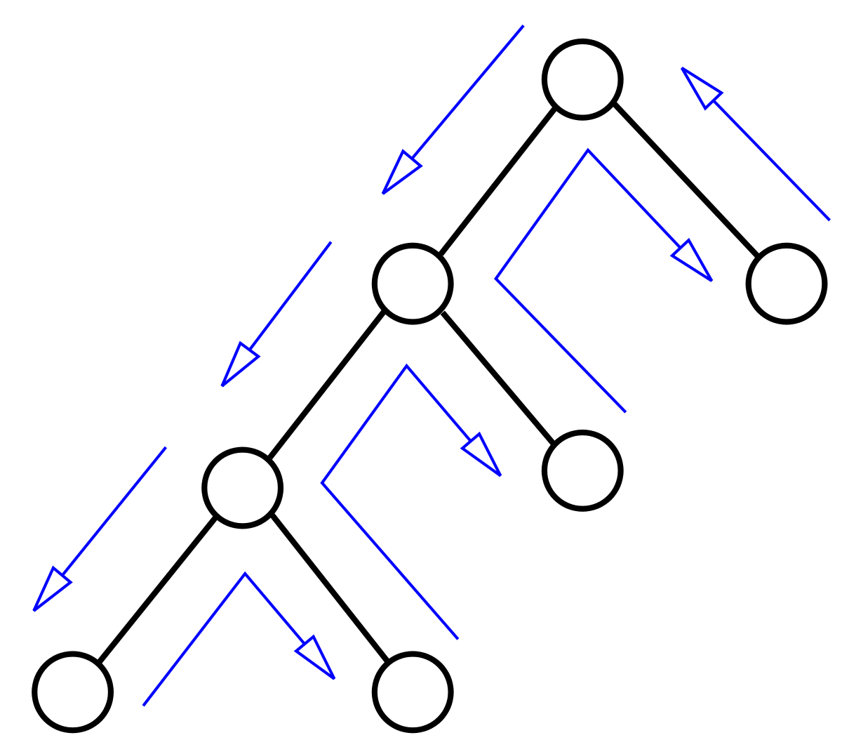
Chronological Backtracking
Backtracking to the highest decision level that has not been tried with both values
Originally proposed in the DLL paper in 1962
OK for randomly generated instances, bad for instances generated in practical applications
We can do better than that
Lintao Zhang

Slide 3
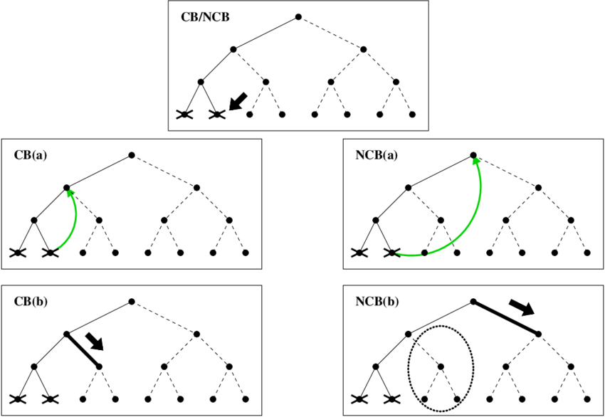
Chronological Backtracking
We can do better than that

Slide 4
Conflict Driven Learning and Non-chronological Backtracking
1.
2.
3.
4.
5.
6.
7.
8.
Notation: + is “or” (V), a ‘ is “not”, ¬
So: x1 + x3’ + x8’ = x1 V ¬x3 V ¬x8
x1 + x4
x1 + x3’ + x8’
x1 + x8 + x12 x2 + x11
x7’ + x3’ + x9 x7’ + x8 + x9’ x7 + x8 + x10’
x7 + x10 + x12’
Lintao Zhang

Slide 5

Conflict Driven Learning and Non-chronological Backtracking
1.
2.
3.
4.
5.
6.
7.
8.
x1
x1=0
x1 + x4
x1 + x3’ + x8’
x1 + x8 + x12 x2 + x11
x7’ + x3’ + x9 x7’ + x8 + x9’ x7 + x8 + x10’
x7 + x10 + x12’
x1=0
Lintao Zhang

Slide 6

Conflict Driven Learning and Non-chronological Backtracking
1.
2.
3.
4.
5.
6.
7.
8.
x1
x1=0, x4=1
x1 + x4
x1 + x3’ + x8’
x1 + x8 + x12 x2 + x11
x7’ + x3’ + x9 x7’ + x8 + x9’ x7 + x8 + x10’
x7 + x10 + x12’
x4=1
x1=0
Lintao Zhang

Slide 7
Conflict Driven Learning and Non-chronological Backtracking
1.
2.
3.
4.
5.
6.
7.
8.
x1
x1=0, x4=1
x1 + x4
x1 + x3’ + x8’
x1 + x8 + x12 x2 + x11
x7’ + x3’ + x9 x7’ + x8 + x9’ x7 + x8 + x10’
x7 + x10 + x12’
x3
x3=1
x4=1
x1=0
x3=1
Lintao Zhang

Slide 8
Conflict Driven Learning and Non-chronological Backtracking
1.
2.
3.
4.
5.
6.
7.
8.
x1
x1=0, x4=1
x1 + x4
x1 + x3’ + x8’
x1 + x8 + x12 x2 + x11
x7’ + x3’ + x9 x7’ + x8 + x9’ x7 + x8 + x10’
x7 + x10 + x12’
x3
x3=1, x8=0
x4=1
x1=0
x3=1
x8=0
Lintao Zhang

Slide 9
Conflict Driven Learning and Non-chronological Backtracking
1.
2.
3.
4.
5.
6.
7.
8.
x1
x1=0, x4=1
x1 + x4
x1 + x3’ + x8’
x1 + x8 + x12 x2 + x11
x7’ + x3’ + x9 x7’ + x8 + x9’ x7 + x8 + x10’
x7 + x10 + x12’
x3
x3=1, x8=0, x12=1
x4=1
x1=0
x3=1
x8=0
x12=1
Lintao Zhang

Slide 10
Conflict Driven Learning and Non-chronological Backtracking
1.
2.
3.
4.
5.
6.
7.
8.
x1
x1=0, x4=1
x1 + x4
x1 + x3’ + x8’
x1 + x8 + x12 x2 + x11
x7’ + x3’ + x9 x7’ + x8 + x9’ x7 + x8 + x10’
x7 + x10 + x12’
x3
x3=1, x8=0, x12=1
x2
x2=0
x4=1
x1=0
x3=1
x8=0
x12=1
X2 = 0
Lintao Zhang

Slide 11
Conflict Driven Learning and Non-chronological Backtracking
1.
2.
3.
4.
5.
6.
7.
8.
x1
x1=0, x4=1
x1 + x4
x1 + x3’ + x8’
x1 + x8 + x12 x2 + x11
x7’ + x3’ + x9 x7’ + x8 + x9’ x7 + x8 + x10’
x7 + x10 + x12’
x3
x3=1, x8=0, x12=1
x2
x2=0, x11=1
x4=1
x1=0
x3=1
x8=0
x12=1
x11=1
L X2 = 0
Lintao Zhang

Slide 12
Conflict Driven Learning and Non-chronological Backtracking
1.
2.
3.
4.
5.
6.
7.
8.
x1
x1=0, x4=1
x1 + x4
x1 + x3’ + x8’
x1 + x8 + x12 x2 + x11
x7’ + x3’ + x9 x7’ + x8 + x9’ x7 + x8 + x10’
x7 + x10 + x12’
x3
x3=1, x8=0, x12=1
x2
x2=0, x11=1
x4=1
x7
x7=1
x1=0
x3=1
x7=1
x8=0
x12=1
x11=1
X2 = 0
Lintao Zhang

Slide 13
Conflict Driven Learning and Non-chronological Backtracking
1.
2.
3.
4.
5.
6.
7.
8.
x1
x1=0, x4=1
x1 + x4
x1 + x3’ + x8’
x1 + x8 + x12 x2 + x11
x7’ + x3’ + x9 x7’ + x8 + x9’ x7 + x8 + x10’
x7 + x10 + x12’
x3
x3=1, x8=0, x12=1
x2
x2=0, x11=1
x4=1
x7
x7=1, x9= 0, 1
x9=1
x1=0
x3=1
x7=1
x9=0
x8=0
x12=1
x11=1
X2 = 0
Lintao Zhang

Slide 14
Conflict Driven Learning and Non-chronological Backtracking
1.
2.
3.
4.
5.
6.
7.
8.
x1
x1=0, x4=1
x1 + x4
x1 + x3’ + x8’
x1 + x8 + x12 x2 + x11
x7’ + x3’ + x9 x7’ + x8 + x9’ x7 + x8 + x10’
x7 + x10 + x12’
x3
x3=1, x8=0, x12=1
x2
x2=0, x11=1
x4=1
x7
x7=1, x9=1
x9=1
x1=0
x3=1
x7=1
x9=0
x8=0
x12=1
x3=1∧x7=1∧x8=0 → conflict
x11=1
X2 = 0
Lintao Zhang

Slide 15
Conflict Driven Learning and Non-chronological Backtracking
1.
2.
3.
4.
5.
6.
7.
8.
x1
x1=0, x4=1
x1 + x4
x1 + x3’ + x8’
x1 + x8 + x12 x2 + x11
x7’ + x3’ + x9 x7’ + x8 + x9’ x7 + x8 + x10’
x7 + x10 + x12’
x3
x3=1, x8=0, x12=1
x2
x2=0, x11=1
x4=1
x7
x7=1, x9=1
x9=1
x1=0
x3=1
x7=1
x9=0
x8=0
x12=1
x3=1∧x7=1∧x8=0 → conflict
x11=1
X2 = 0
Add conflict clause: x3’+x7’+x8
Lintao Zhang

Slide 16
Conflict Driven Learning and Non-chronological Backtracking
1.
2.
3.
4.
5.
6.
7.
8.
x1
x1=0, x4=1
x1 + x4
x1 + x3’ + x8’
x1 + x8 + x12 x2 + x11
x7’ + x3’ + x9 x7’ + x8 + x9’ x7 + x8 + x10’
x7 + x10 + x12’
x3
x3=1, x8=0, x12=1
x3’+x7’+x8
x2
x2=0, x11=1
x4=1
x7
x7=1, x9=1
x9=1
x1=0
x3=1
x7=1
x9=0
x8=0
x12=1
x3=1∧x7=1∧x8=0 → conflict
x11=1
X2 = 0
Add conflict clause: x3’+x7’+x8

Slide 17
DLL with Non-Chronological Backtracking and Learning
1.
2.
3.
4.
5.
6.
7.
8.
x1=0, x4=1
x1 + x4
x1 + x3’ + x8’ x1 + x8 + x12 x2 + x11
x7’ + x3’ + x9
x7’ + x8 + x9’ x7 + x8 + x10’ x7 + x10 + x12’ x3’ + x8 + x7’
x1
x3
x3=1, x8=0, x12=1
x2
x4=1
x7
x1=0
x3=1
x11=1
x8=0
x12=1
Backtrack to the decision level of x3=1: x7 = 0
x2=0
Lintao Zhang

Slide 18
DLL with Non-Chronological Backtracking and Learning
1.
2.
3.
4.
5.
6.
7.
8.
x1=0, x4=1
x1 + x4
x1 + x3’ + x8’ x1 + x8 + x12 x2 + x11
x7’ + x3’ + x9
x7’ + x8 + x9’ x7 + x8 + x10’ x7 + x10 + x12’ x3’ + x8 + x7’
x1
x3
x3=1, x8=0, x12=1, x7=0
x4=1
x1=0
x3=1
x7=0
x11=1
x8=0
x12=1
x2=0
Lintao Zhang

Slide 19
Summarising
We have now gained two advantages:
We have “learned” a new clause that “summarises” a potential conflict. Adding this clause to the clause base will help us to avoid making the same mistake in other parts of the search space.
We can make a bigger “jump back” in the search tree, replacing chronological backtracking (= just undoing the most recent choice), with dependency directed backtracking (= undoing the most recent choice that was involved in the conflict, ie the most recent choice that mattered).

Slide 20
For an excellent animated explanation of DP and of Clause Learning, see https://cse442-17f.github.io/Conflict-Driven-Clause-Learning/ If you do the exercises there, you’ll be in pretty good shape about understanding DP and Clause Learning
Note that they even demonstrate the gain of Clause Learning through a sudoku example at the end of the page
Notes on terminology:
They use the historically more correct name: DPLL
They use the term “Boolean Constraint Propagation” for the simplification steps that follow from a unit literal.

